Slide 1
Time Series Prediction for Stock Price and Opioid Incident Location
By Kevin Thomas

Slide 2
Committee Members
Dr. Arunabha Sen, Chair
Dr. Hasan Davulcu
Dr. Ayan Banerjee

Slide 3


Overview
What is Time Series?
What is Time Series Forecasting?
What is the Stock Price Prediction Problem?
What is the Opioid Incident Location Prediction Problem?

Slide 4
Part I: Stock Data Prediction

Slide 5
Introduction
What is the Stock Market?
How does the Stock Market work?
Why is the Stock Market so unpredictable?

Slide 6

Problem Statement
Predict the closing price for a future time instance given the stock data of the past time instances.

Slide 7
Input Data
Minute Data from September 2017 to March 2019
10 companies
20 features per company
Data Source: FirstRateData site (First Rate Data 2019)

Slide 8
The 10 companies are…
3M (MMM)
Amazon (AMZN)
American Express (AXP)
Apple Inc. (AAPL)
Cisco Systems (CSCO)
Chevron (CVX)
J.P Morgan Chase and Co. (JPM)
Procter & Gamble (PG)
Verizon (VZ)
Walmart (WMT)

Slide 9
Features provided by FirstRateData…
Open: the opening stock price of the minute
Close: the closing stock price of the minute
High: the highest stock price of the minute
Low: the lowest stock price of the minute
Volume: the number of shares traded in the minute
Number of trades: the number of trades occurred in the minute. One trade can have more than one share traded in it.
Weighted Average Price: the weighted average price of the stock in the minute

Slide 10
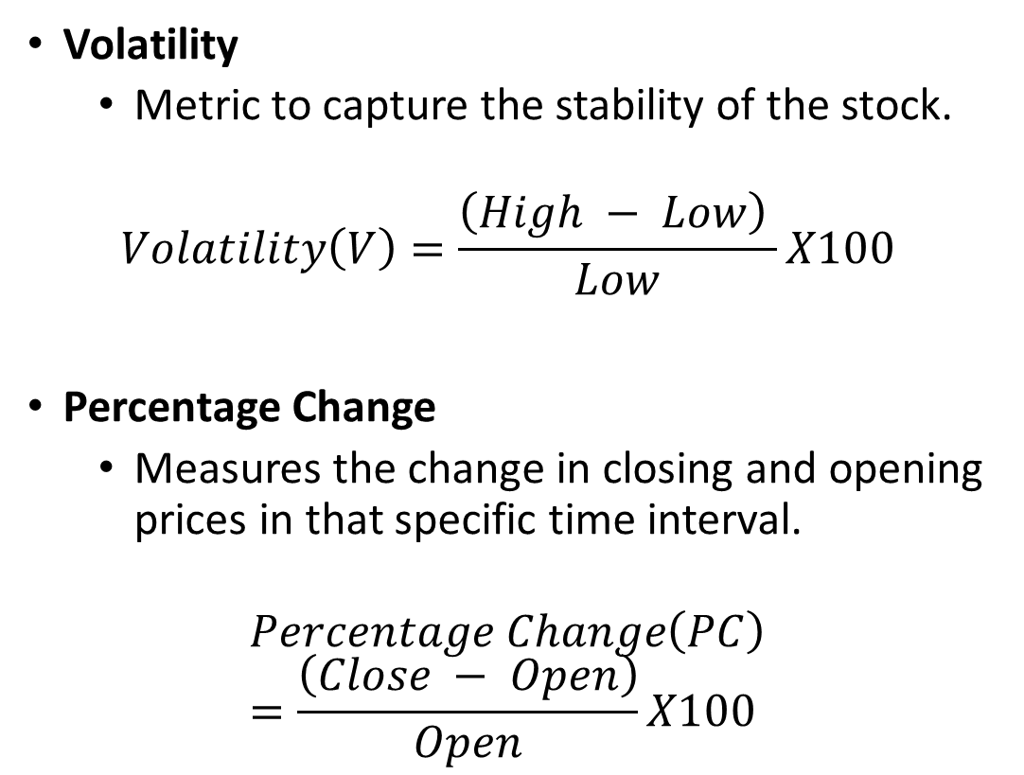
Features calculated by us…
Volatility
Metric to capture the stability of the stock.
$$Volatility\left(V\right)=\frac{\left(High − Low\right) }{Low}X100$$
Percentage Change
Measures the change in closing and opening prices in that specific time interval.
$$Percentage Change\left(PC\right)=\frac{\left(Close − Open\right)}{Open}X100$$

Slide 11
Features calculated by us…(contd.)
Fast Fourier Transform
Computes the Discrete Fourier Transform (DFT) or Inverse Discrete Fourier Transform (IDFT) of a sequence in O(NlogN) time.
DFT: Converts signal from time domain into the frequency domain.
IDFT: Converts signal from frequency domain into the time domain.
Captures the long-term and the short-term trends by varying the frequencies.
Simple Moving Average (SMA)
Helps cut out the noise in the stock price data. Since the average is captured over a window, it captures the trend perfectly and removes the noise at the same time.

Slide 12
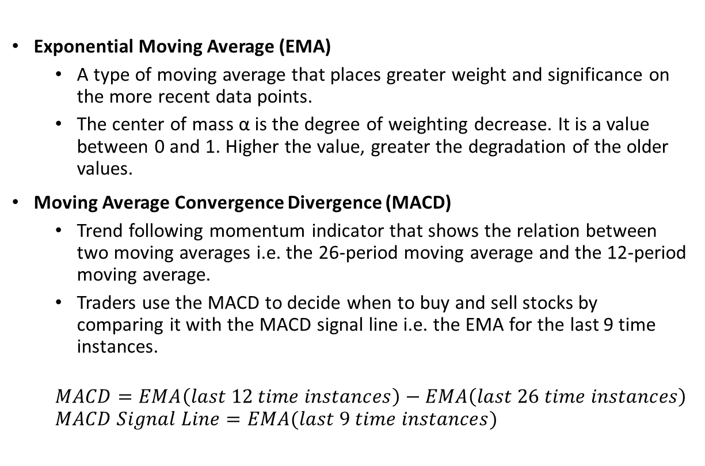
Features calculated by us…(contd.)
Exponential Moving Average (EMA)
A type of moving average that places greater weight and significance on the more recent data points.
The center of mass α is the degree of weighting decrease. It is a value between 0 and 1. Higher the value, greater the degradation of the older values.
Moving Average Convergence Divergence (MACD)
Trend following momentum indicator that shows the relation between two moving averages i.e. the 26-period moving average and the 12-period moving average.
Traders use the MACD to decide when to buy and sell stocks by comparing it with the MACD signal line i.e. the EMA for the last 9 time instances.
$$MACD=EMA\left(last 12 time instances\right)−EMA\left(last 26 time instances\right)$$
$$MACD Signal Line=EMA(last 9 time instances)$$

Slide 13
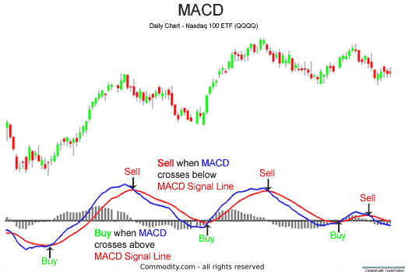
MACD and MACD Signal Line
Courtesy: Google Images

Slide 14
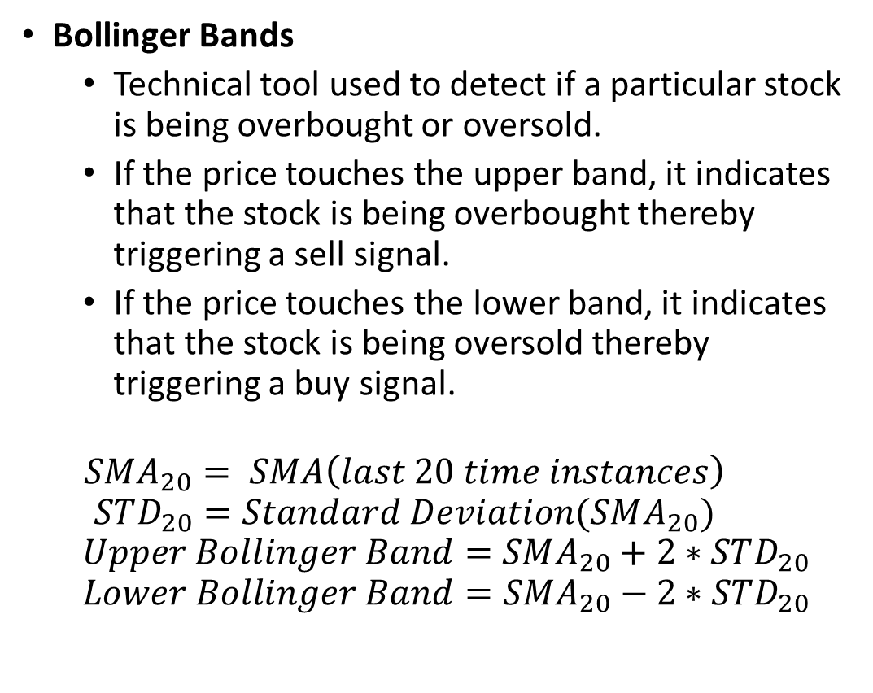
Features calculated by us…(contd.)
Bollinger Bands
Technical tool used to detect if a particular stock is being overbought or oversold.
If the price touches the upper band, it indicates that the stock is being overbought thereby triggering a sell signal.
If the price touches the lower band, it indicates that the stock is being oversold thereby triggering a buy signal.
$$SMA_{20}= SMA\left(last 20 time instances\right)$$
$$STD_{20}=Standard Deviation(SMA_{20})$$
$$Upper Bollinger Band=SMA_{20}+2∗STD_{20}$$
$$Lower Bollinger Band=SMA_{20}−2∗STD_{20}$$

Slide 15
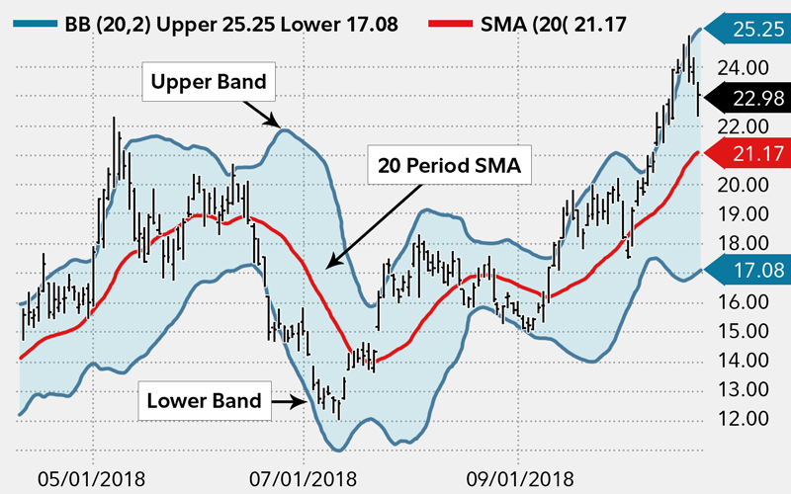
Bollinger Bands
Courtesy: Google Images

Slide 16
The 20 Features taken into consideration are…
Open
Close
High
Low
Volume
Number of trades
Weighted Average Price
Volatility
Percentage Change
FFT with frequency 10 Hz
FFT with frequency 20 Hz
FFT with frequency 50 Hz
Moving Average of the 1-day-period
Moving Average of the 3-day-period
Moving Average of the 7-day period
MACD
Upper Bollinger Band
Lower Bollinger Band
Exponential Moving Average with Center of Mass as 0.5
Exponential Moving Average with Center of Mass as 0.25

Slide 17

Concepts

Slide 18
Long Short-Term Memory (LSTM)
A type of Recurrent Neural Network (RNN)
Has a memory cell and 3 gates: Input, Output and Forget
Can “remember” input details, making it perfect for time series.
Learns the temporal relations between features.

Slide 19
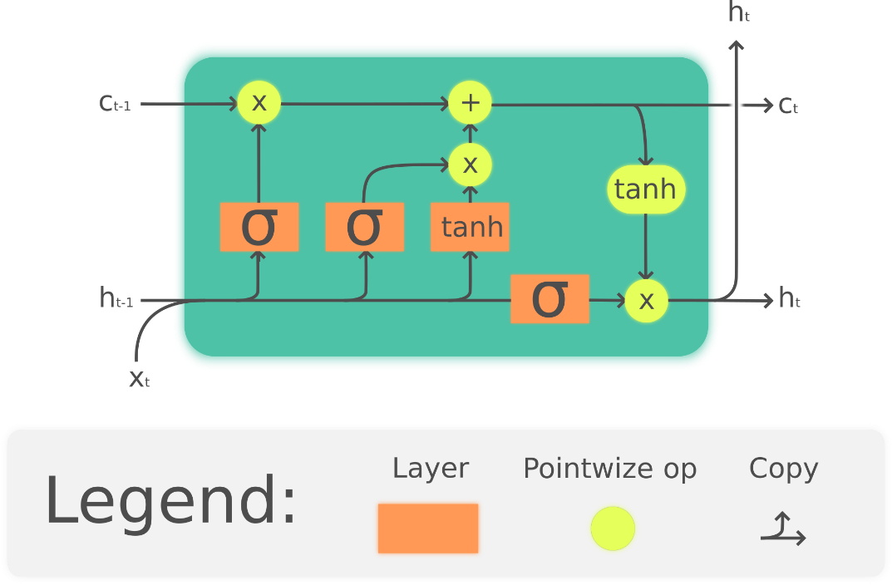
LSTM Cell
Courtesy: Wikipedia

Slide 20
Convolutional Neural Networks (CNNs/ConvNets)
Applies a filter/kernel over the input, which is used to capture relations in the input data.
The output of the convolution is passed to a neural network.
Learns the spatial relations between features because of the convolution operation.
Excellent option when the input is an image.

Slide 21

CNN Example
Courtesy: Google Images

Slide 22
Convolutional LSTMs (ConvLSTMs)
Combination of CNN and LSTM.
Replace the Dense layers with LSTM layers.
Being a combination of CNN and LSTM, it learns the spatiotemporal relations between features.

Slide 23
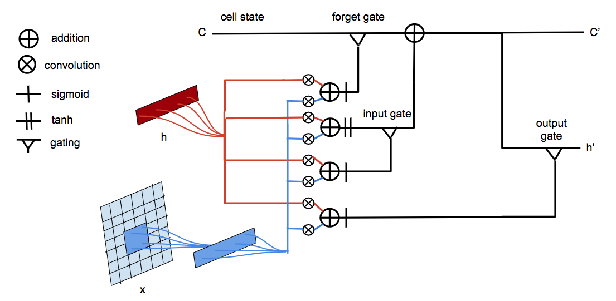
ConvLSTM Example
Courtesy: Google Images

Slide 24
Dropout
Used to prevent overfitting in neural networks.
During training, some number of layer outputs are randomly ignored or “dropped out”.
This has the effect of making the layer look-like and be treated like a layer with a different number of nodes and connectivity to the prior layer.
This makes the training process noisy, forcing nodes within a layer to probabilistically take on more or less responsible for the inputs, thereby avoiding overfitting.
This is proved by the work of (Srivastava et al. 2014)

Slide 25
Batch Normalization
Batch Normalization is a regularization technique used to improve the speed, performance, and stability of the neural network.
It forces the model to converge faster by normalizing the distribution of the inputs layers (Ioffe et al. 2015).

Slide 26
Attention
There may be cases that when predicting outputs using a neural network, some features will be more discriminating than the others.
An attention layer will go through the input and output and assign weights to each feature thereby giving each feature a quantified value for the importance it has to the output.

Slide 27
Generative Adversarial Network (GAN)
Analogy: Cop-Fraudster-Bank analogy
The generator produces values which are then combined with ground truth values and the discriminator must try to discriminate between the ground truth values and the generator values.
If the discriminate cannot discriminate between the values, then the discriminator must reduce the value of the loss function through backpropagation and if it can, then the generator must use backpropagation to reduce its loss function.
Both nets are trying to optimize a different and opposing loss function in a zero-sum game.

Slide 28
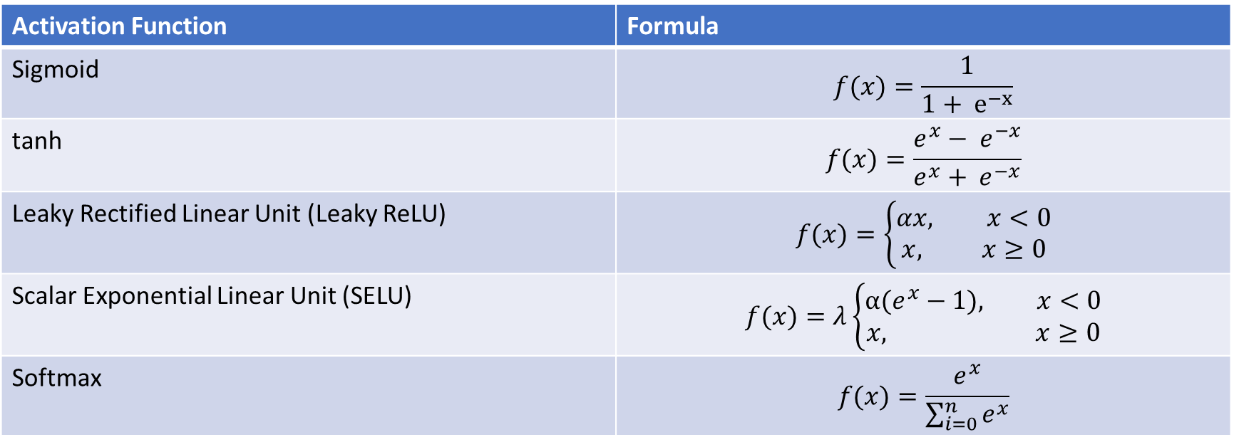
Activation Functions used…
Activation Function | Formula
Sigmoid | $$f(x)=\frac{1}{1+ e^{−x}}$$
tanh | $$f(x)=\frac{e^{x}− e^{−x}}{e^{x}+ e^{−x}}$$
Leaky Rectified Linear Unit (Leaky ReLU) | $$f(x)=\left\{\begin{aligned}αx, x<0 \\ x, x≥0\end{aligned}\right.$$
Scalar Exponential Linear Unit (SELU) | $$f(x)=λ\left\{\begin{aligned}α(e^{x}−1), x<0 \\ x, x≥0\end{aligned}\right.$$
Softmax | $$f(x)=\frac{e^{x}}{\sum_{i=0}^{n}{e^{x}}}$$

Slide 29
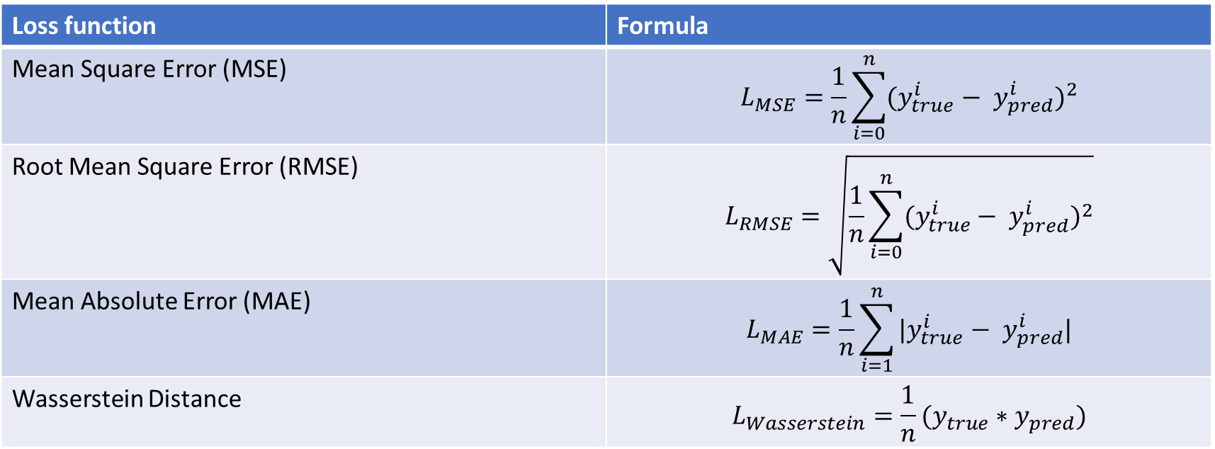
Loss Functions used…
Loss function | Formula
Mean Square Error (MSE) | $$L_{MSE}=\frac{1}{n}\sum_{i=0}^{n}{{(y_{true}^{i}− y_{pred}^{i})}^{2}}$$
Root Mean Square Error (RMSE) | $$L_{RMSE}=\sqrt{\frac{1}{n}\sum_{i=0}^{n}{{(y_{true}^{i}− y_{pred}^{i})}^{2}}}$$
Mean Absolute Error (MAE) | $$L_{MAE}=\frac{1}{n}\sum_{i=1}^{n}{{|y}_{true}^{i}− y_{pred}^{i}|}$$
Wasserstein Distance | $$L_{Wasserstein}=\frac{1}{n}(y_{true}∗y_{pred})$$

Slide 30

Implementation

Slide 31
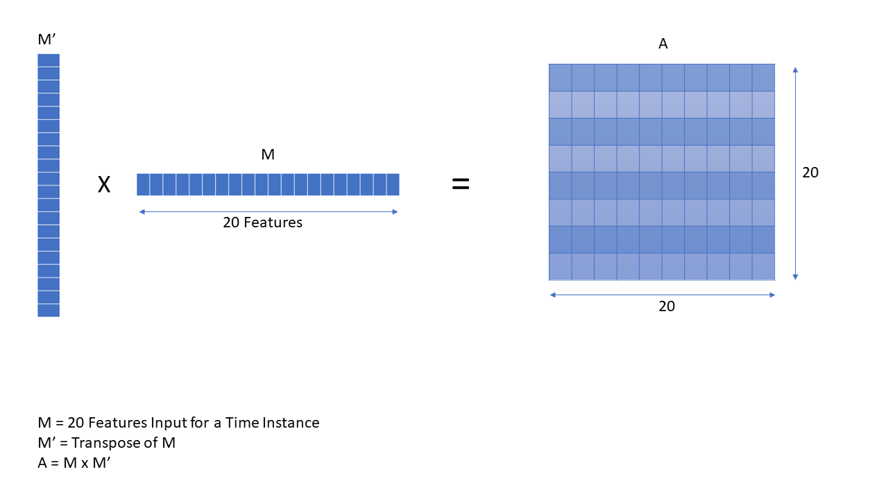
Affinity Matrix

Slide 32
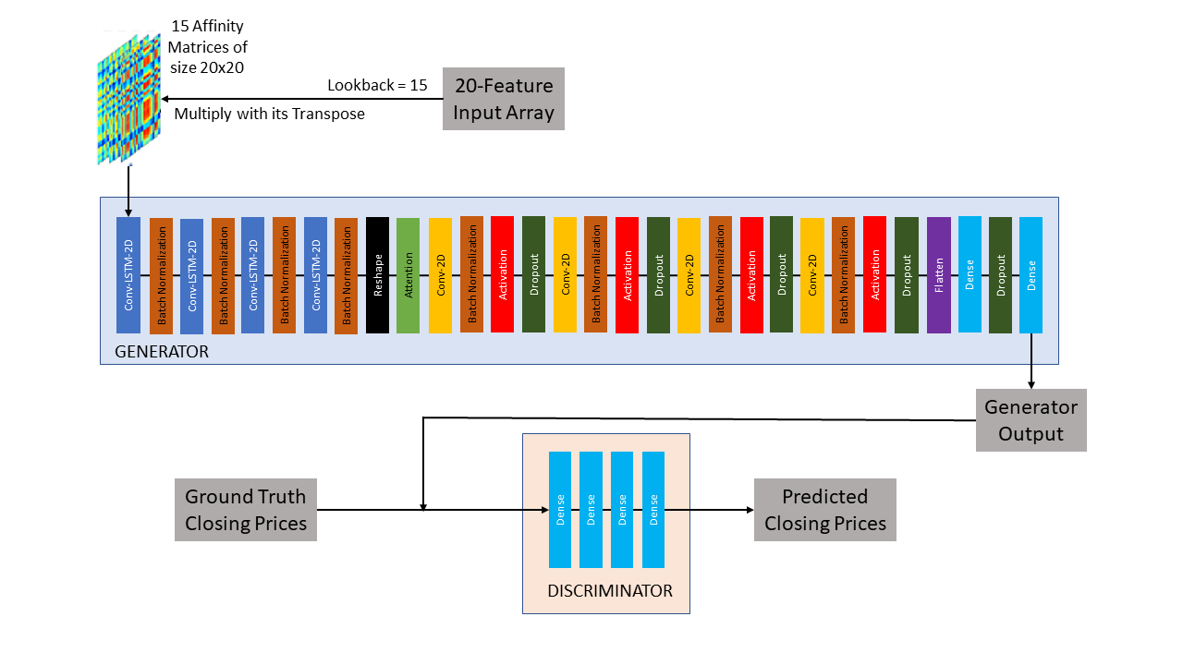
GAN Model for Stock Data Prediction

Slide 33
Model Structure
Generator:
Two-Dimensional Convolutional LSTM Layer with 32 units, a 3x3 filter, a 1x1 stride and ‘same’ padding.
Batch Normalization Layer
Two-Dimensional Convolutional LSTM Layer with 64 units, a 3x3 filter, a 1x1 stride and ‘same’ padding.
Batch Normalization Layer
Two-Dimensional Convolutional LSTM Layer with 128 units, a 3x3 filter, a 1x1 stride and ‘same’ padding.
Batch Normalization Layer
Two-Dimensional Convolutional LSTM Layer with 256 units, a 3x3 filter, a 1x1 stride and ‘same’ padding.
Batch Normalization Layer
The outputs from 2, 4, 6 and 8 are reshaped and concatenated to form a stack on top of each other to form a matrix.
An attention layer is created by applying the mean function on the product of a Three-Dimensional Convolution with 1 unit, a 1x1x1 filter, a 1x1x1 stride, ‘valid’ padding and ‘softmax’ activation function. The input is the output from step 9.
Two-Dimensional Convolution Layer with 512 units, a 3x3 filter, a 2x2 stride, and ‘valid’ padding.
Batch Normalization Layer
Leaky ReLU Activation Layer with α = 0.2

Slide 34
Model Structure (contd.)
Generator(contd.):
Dropout with dropout rate = 0.3
Two-Dimensional Convolution Layer with 256 units, a 3x3 filter, a 2x2 stride, and ‘valid’ padding.
Batch Normalization Layer
Leaky ReLU Activation Layer with α = 0.2
Dropout with dropout rate = 0.3
Two-Dimensional Convolution Layer with 128 units, a 3x3 filter, a 2x2 stride, and ‘valid’ padding.
Batch Normalization Layer
Leaky ReLU Activation Layer with α = 0.2
Dropout with dropout rate = 0.3
Two-Dimensional Convolution Layer with 64 units, a 3x3 filter, a 2x2 stride, and ‘valid’ padding.
Batch Normalization Layer
Leaky ReLU Activation Layer with α = 0.2
Dropout with dropout rate = 0.3
Flatten
Dense Layer of 100 units and of Leaky ReLU activation with α = 0.2
Dense Layer of 1 unit with tanh activation.

Slide 35
Model Structure(contd.)
Discriminator:
Dense Layer of 1 unit and of Leaky ReLU activation with α = 0.2
Dense Layer of 1 unit and of Leaky ReLU activation with α = 0.2
Dense Layer of 1 unit and of Leaky ReLU activation with α = 0.2
Dense Layer of 1 unit and of tanh activation

Slide 36

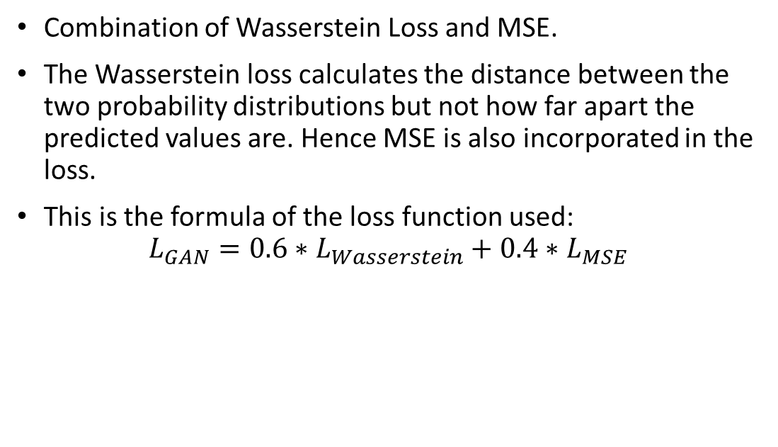
Loss Function
Combination of Wasserstein Loss and MSE.
The Wasserstein loss calculates the distance between the two probability distributions but not how far apart the predicted values are. Hence MSE is also incorporated in the loss.
This is the formula of the loss function used:
$$L_{GAN}=0.6∗L_{Wasserstein}+0.4∗L_{MSE}$$

Slide 37
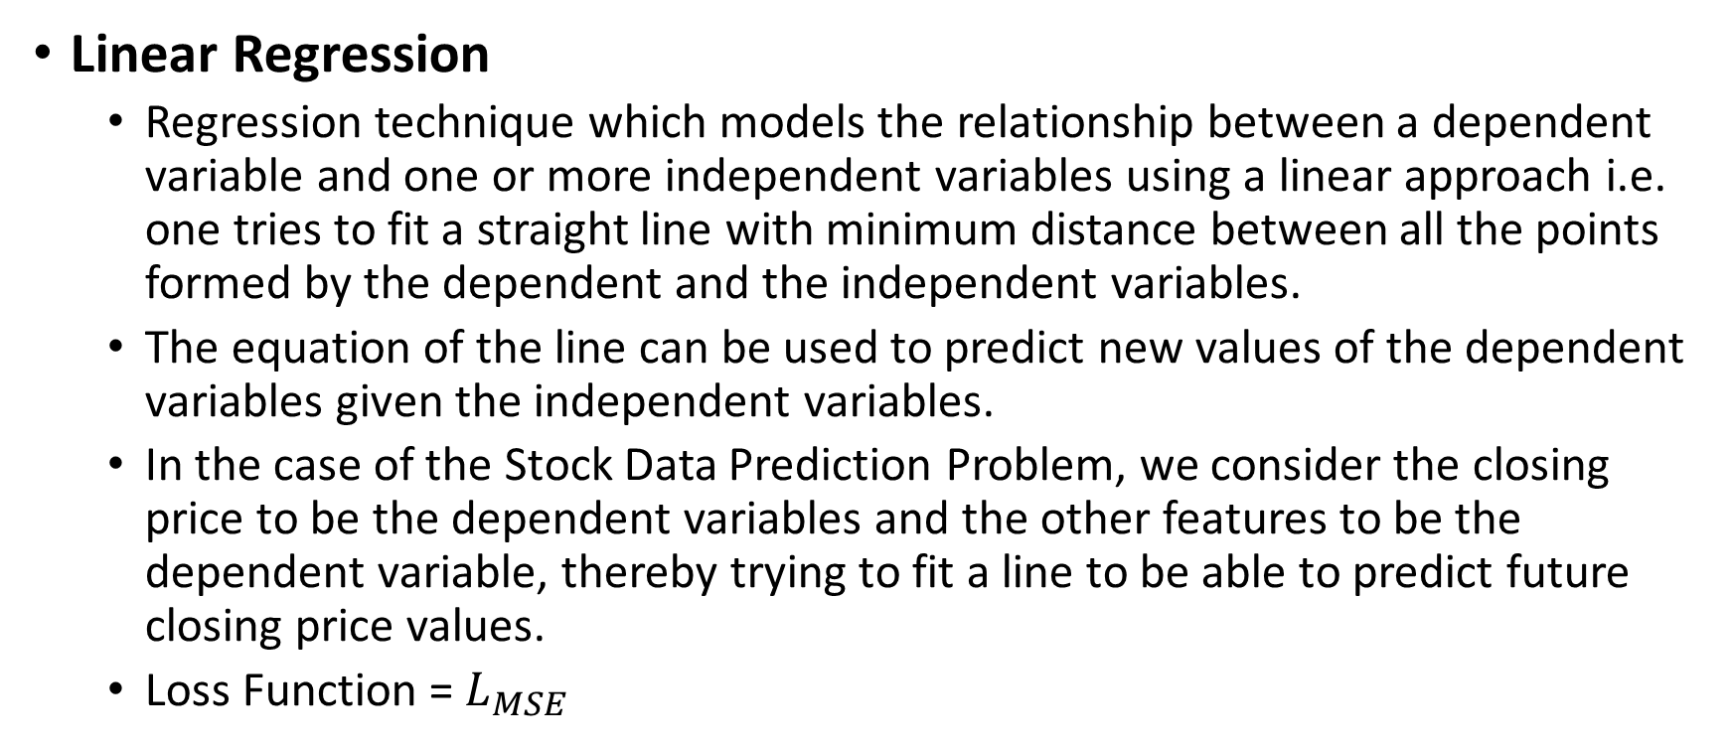
Regression Techniques
Linear Regression
Regression technique which models the relationship between a dependent variable and one or more independent variables using a linear approach i.e. one tries to fit a straight line with minimum distance between all the points formed by the dependent and the independent variables.
The equation of the line can be used to predict new values of the dependent variables given the independent variables.
In the case of the Stock Data Prediction Problem, we consider the closing price to be the dependent variables and the other features to be the dependent variable, thereby trying to fit a line to be able to predict future closing price values.
Loss Function = $L_{MSE}$

Slide 38

Linear Regression
Courtesy: Wikipedia

Slide 39
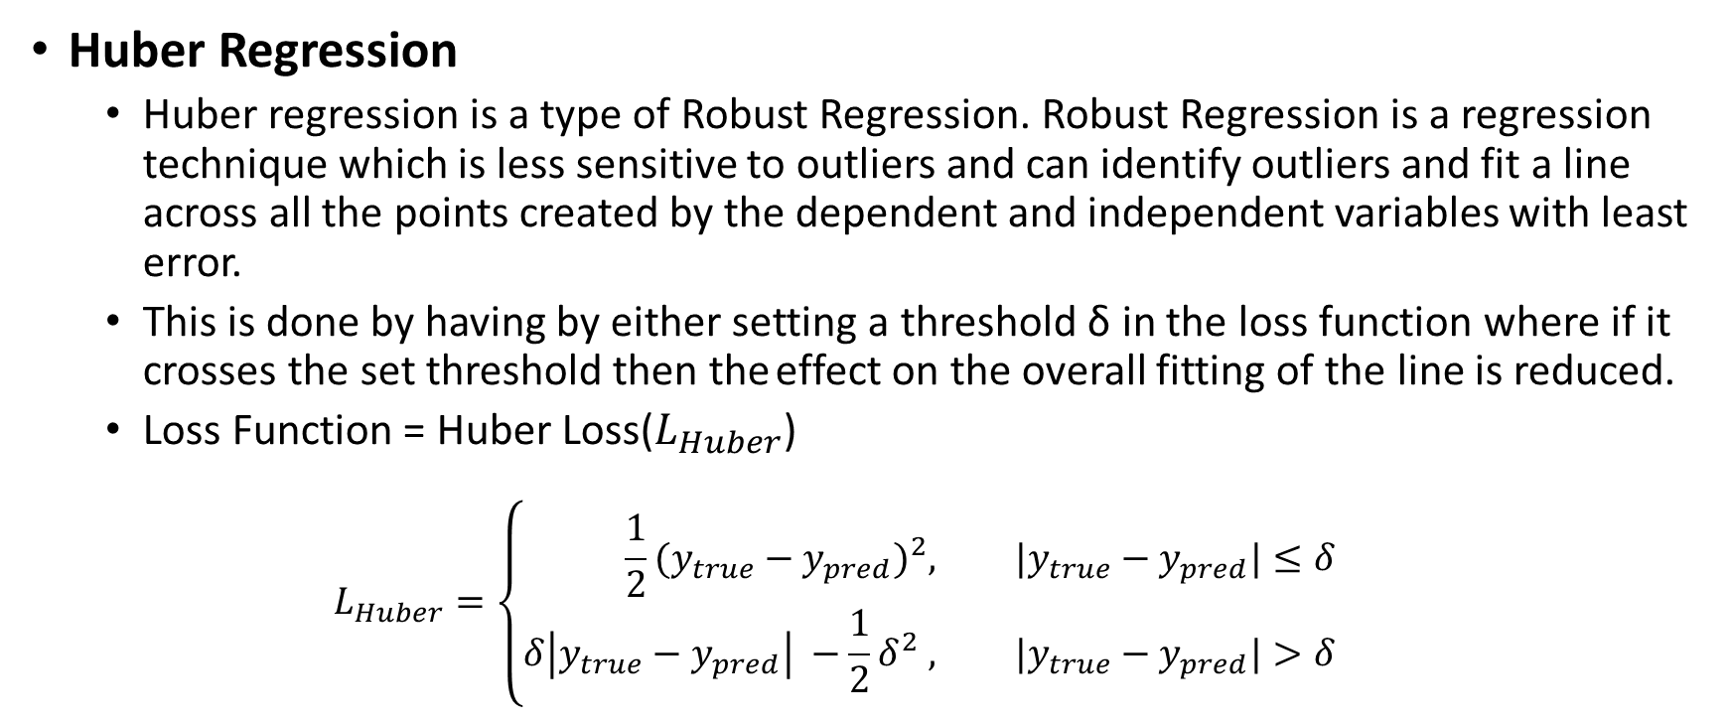
Regression Techniques (contd.)
Huber Regression
Huber regression is a type of Robust Regression. Robust Regression is a regression technique which is less sensitive to outliers and can identify outliers and fit a line across all the points created by the dependent and independent variables with least error.
This is done by having by either setting a threshold δ in the loss function where if it crosses the set threshold then the effect on the overall fitting of the line is reduced.
Loss Function = Huber Loss($L_{Huber}$)
$$L_{Huber}=\left\{\begin{aligned}\frac{1}{2}{(y_{true}−y_{pred})}^{2}, &|y_{true}−y_{pred}|≤δ \\ δ\left|y_{true}−y_{pred}\right| −\frac{1}{2}δ^{2} , &{|y}_{true}−y_{pred}|>δ\end{aligned}\right.$$

Slide 40
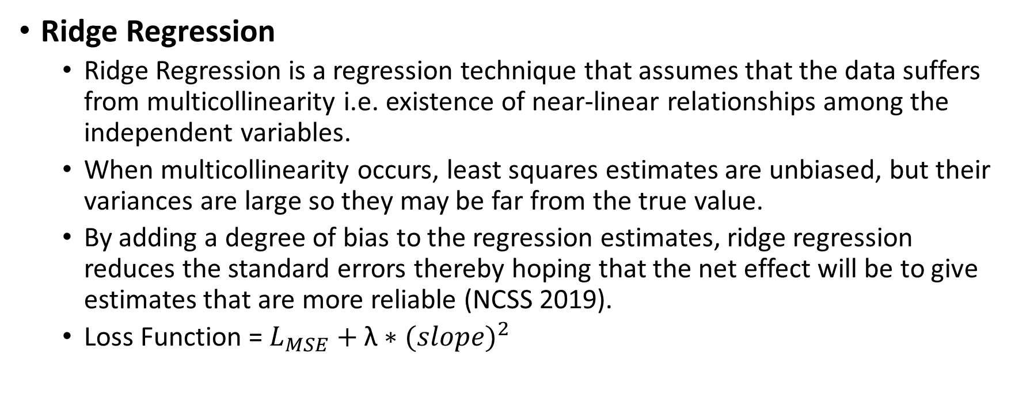
Regression Techniques (contd.)
Ridge Regression
Ridge Regression is a regression technique that assumes that the data suffers from multicollinearity i.e. existence of near-linear relationships among the independent variables.
When multicollinearity occurs, least squares estimates are unbiased, but their variances are large so they may be far from the true value.
By adding a degree of bias to the regression estimates, ridge regression reduces the standard errors thereby hoping that the net effect will be to give estimates that are more reliable (NCSS 2019).
Loss Function = $L_{MSE}+\text{λ}∗{(slope)}^{2}$

Slide 41
Results
Tables 1 to 6 displays the results for the comparison experiments.
Graphs 1 to 17 displays the Ground truth and Predicted values plots on a closing price vs time graph
Three types of predictions:
Prediction for the next minute
Prediction for 1000 minutes later(3 days later)
Prediction for 3000 minutes later(7 days later)

Slide 42
Table 1: RMSE of all models for all companies for next minute prediction
Method | AAPL | AMZN | AXP | CSCO | CVX | JPM | MMM | PG | VZ | WMT
Linear Regression | 0.172 | 1.496 | 0.052 | 0.027 | 0.109 | 0.064 | 0.138 | 0.078 | 0.036 | 0.057
Huber Regression | 0.419 | 1.814 | 0.085 | 0.056 | 0.135 | 0.112 | 0.189 | 0.093 | 0.048 | 0.073
Ridge Regression | 0.172 | 1.496 | 0.052 | 0.027 | 0.109 | 0.064 | 0.138 | 0.078 | 0.036 | 0.057
LSTM | 11.032 | 463.160 | 1.118 | 0.899 | 6.991 | 3.653 | 16.188 | 4.952 | 3.750 | 11.552
GAN Model | 0.052 | 3.386 | 0.087 | 0.176 | 0.045 | 0.024 | 0.044 | 0.223 | 0.031 | 0.031

Slide 43
Table 2: MAE of all models for all companies for next minute prediction
Method | AAPL | AMZN | AXP | CSCO | CVX | JPM | MMM | PG | VZ | WMT
Linear Regression | 0.051 | 0.601 | 0.028 | 0.014 | 0.035 | 0.029 | 0.073 | 0.020 | 0.014 | 0.023
Huber Regression | 0.254 | 0.846 | 0.058 | 0.034 | 0.057 | 0.075 | 0.112 | 0.031 | 0.025 | 0.036
Ridge Regression | 0.051 | 0.601 | 0.028 | 0.014 | 0.035 | 0.029 | 0.072 | 0.020 | 0.014 | 0.023
LSTM | 8.157 | 364.526 | 0.731 | 0.588 | 5.668 | 2.821 | 12.359 | 3.865 | 3.050 | 9.723
GAN Model | 0.032 | 1.613 | 0.060 | 0.042 | 0.026 | 0.020 | 0.030 | 0.155 | 0.021 | 0.024

Slide 44
Table 3: RMSE of all models for all companies for the third day prediction
Method | AAPL | AMZN | AXP | CSCO | CVX | JPM | MMM | PG | VZ | WMT
Linear Regression | 3.078 | 42.140 | 1.364 | 0.894 | 1.696 | 1.207 | 3.203 | 1.180 | 0.771 | 1.145
Huber Regression | 3.592 | 39.555 | 1.258 | 0.991 | 1.691 | 1.367 | 3.045 | 1.273 | 0.885 | 1.125
Ridge Regression | 3.078 | 42.140 | 1.364 | 0.894 | 1.694 | 1.207 | 3.203 | 1.180 | 0.771 | 1.145
LSTM | 29.890 | 445.790 | 2.306 | 1.444 | 6.887 | 2.085 | 15.927 | 5.154 | 3.757 | 11.518
GAN Model | 0.513 | 8.614 | 0.250 | 0.191 | 0.272 | 0.188 | 0.507 | 0.247 | 0.127 | 0.176

Slide 45
Table 4: MAE of all models for all companies for the third day prediction
Method | AAPL | AMZN | AXP | CSCO | CVX | JPM | MMM | PG | VZ | WMT
Linear Regression | 2.263 | 28.640 | 0.965 | 0.575 | 1.162 | 0.886 | 2.554 | 0.840 | 0.583 | 0.833
Huber Regression | 2.440 | 26.981 | 0.898 | 0.641 | 1.151 | 1.045 | 2.435 | 0.892 | 0.615 | 0.798
Ridge Regression | 2.263 | 28.640 | 0.965 | 0.575 | 1.161 | 0.886 | 2.555 | 0.840 | 0.583 | 0.833
LSTM | 23.798 | 357.325 | 1.802 | 1.112 | 5.496 | 1.534 | 12.257 | 3.971 | 3.076 | 10.117
GAN Model | 0.371 | 5.733 | 0.170 | 0.090 | 0.194 | 0.143 | 0.405 | 0.160 | 0.091 | 0.129

Slide 46
Table 5: RMSE of all models for all companies for seventh day prediction
Method | AAPL | AMZN | AXP | CSCO | CVX | JPM | MMM | PG | VZ | WMT
Linear Regression | 5.900 | 61.301 | 2.295 | 1.395 | 2.341 | 1.854 | 5.601 | 1.758 | 1.255 | 1.563
Huber Regression | 6.728 | 56.044 | 2.041 | 1.203 | 2.414 | 1.986 | 5.278 | 1.854 | 1.265 | 1.687
Ridge Regression | 5.900 | 61.301 | 2.294 | 1.400 | 2.342 | 1.854 | 5.577 | 1.757 | 1.255 | 1.562
LSTM | 10.757 | 440.954 | 11.210 | 2.048 | 6.886 | 12.901 | 15.728 | 5.255 | 3.823 | 11.540
GAN Model | 1.140 | 12.033 | 0.457 | 0.192 | 0.443 | 0.405 | 0.795 | 0.341 | 0.233 | 0.282

Slide 47
Table 6: MAE of all models for all companies for the seventh day prediction
Method | AAPL | AMZN | AXP | CSCO | CVX | JPM | MMM | PG | VZ | WMT
Linear Regression | 4.310 | 49.886 | 1.887 | 1.060 | 1.763 | 1.445 | 4.484 | 1.282 | 0.939 | 1.181
Huber Regression | 4.239 | 45.912 | 1.672 | 0.922 | 1.731 | 1.515 | 4.129 | 1.301 | 0.905 | 1.208
Ridge Regression | 4.310 | 49.886 | 1.887 | 1.060 | 1.764 | 1.445 | 4.472 | 1.281 | 0.940 | 1.179
LSTM | 7.748 | 353.705 | 9.985 | 1.526 | 5.566 | 11.463 | 12.240 | 4.052 | 3.109 | 10.184
GAN Model | 0.895 | 9.473 | 0.361 | 0.148 | 0.356 | 0.312 | 0.615 | 0.244 | 0.176 | 0.212

Slide 48
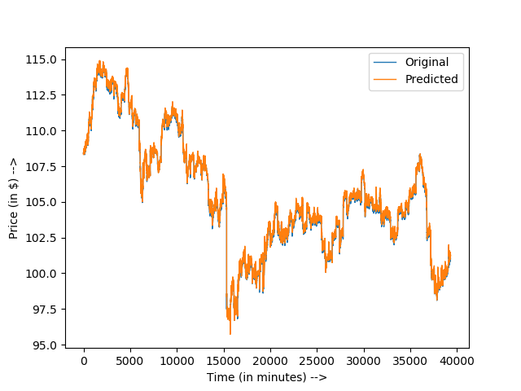
Graph 1: Closing Price Prediction for the next minute for JPM

Slide 49
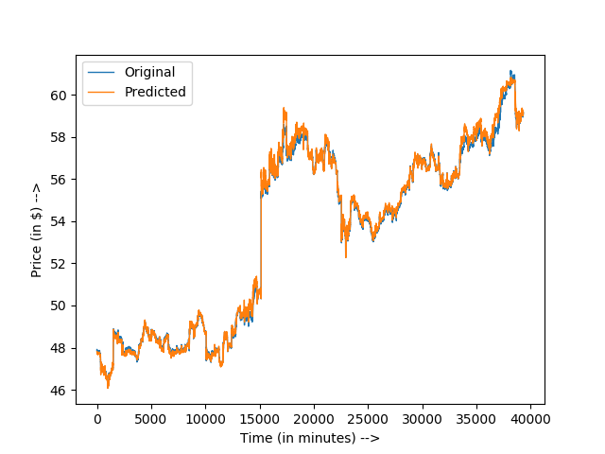
Graph 2: Closing Price Prediction for the next minute for VZ

Slide 50
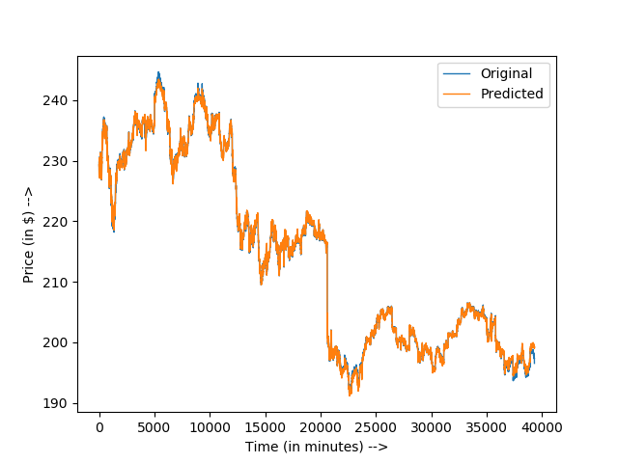
Graph 3: Closing Price Prediction for the next minute for MMM

Slide 51
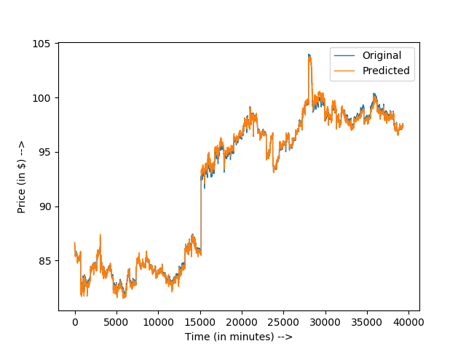
Graph 4: Closing Price Prediction for the next minute for WMT

Slide 52
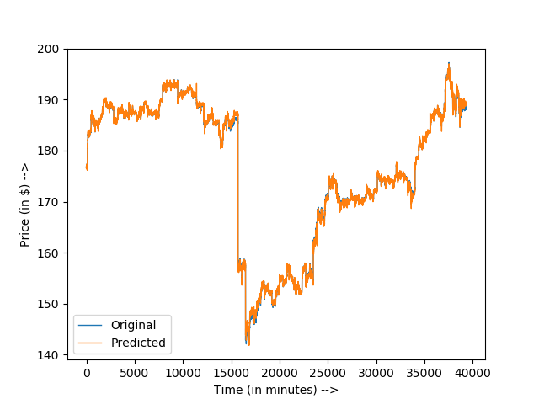
Graph 5: Closing Price Prediction for the next minute for AAPL

Slide 53
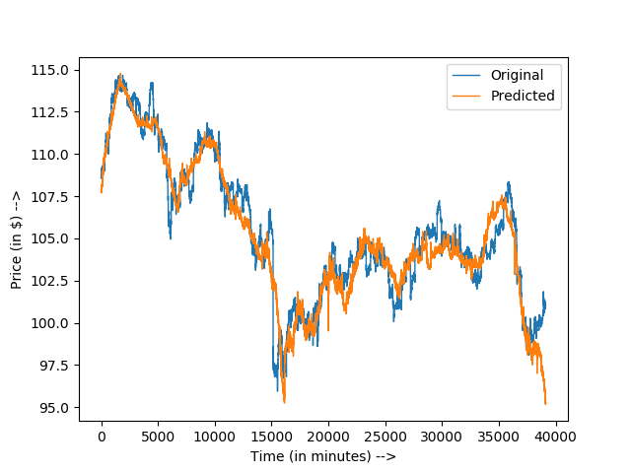
Graph 6: Closing Price Prediction for 1000 minutes later for JPM

Slide 54
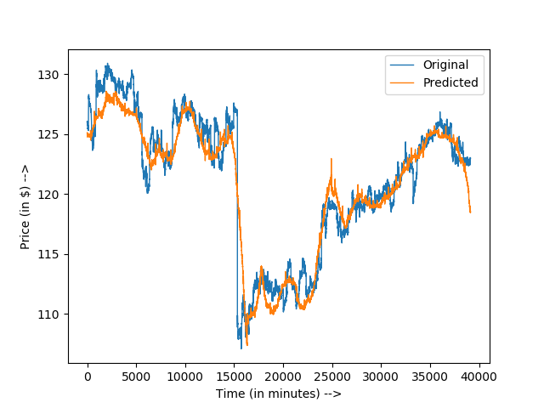
Graph 7: Closing Price Prediction for 1000 minutes later for CVX

Slide 55
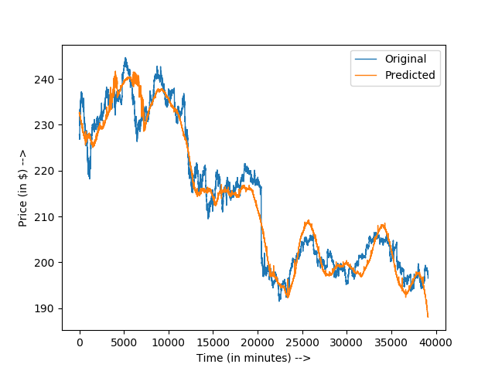
Graph 8: Closing Price Prediction for 1000 minutes later for MMM

Slide 56
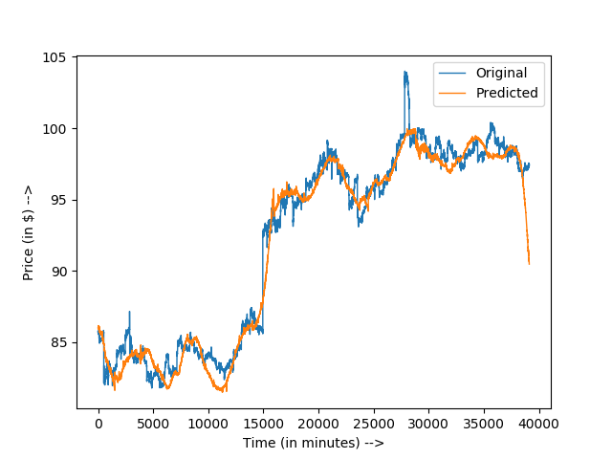
Graph 9: Closing Price Prediction for 1000 minutes later for WMT

Slide 57
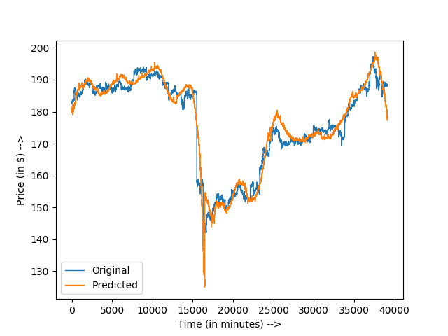
Graph 10: Closing Price Prediction for 1000 minutes later for AAPL

Slide 58
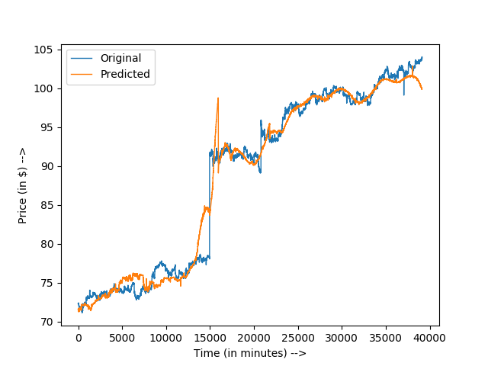
Graph 11: Closing Price Prediction for 1000 minutes later for PG

Slide 59
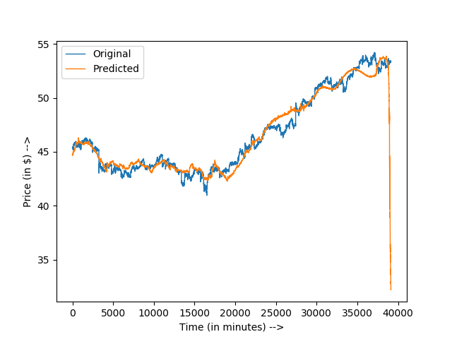
Graph 12: Closing Price Prediction for 1000 minutes later for CSCO

Slide 60
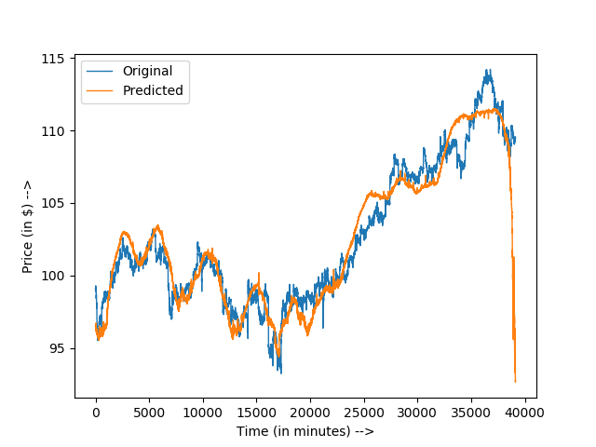
Graph 13: Closing Price Prediction for 1000 minutes later for AMZN

Slide 61
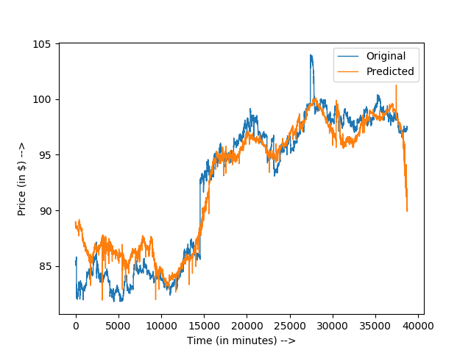
Graph 14: Closing Price Prediction for 3000 minutes later for WMT

Slide 62
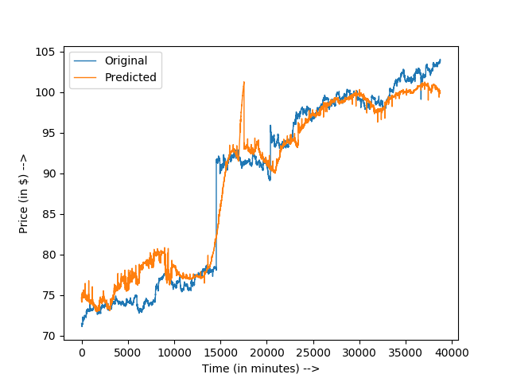
Graph 15: Closing Price Prediction for 3000 minutes later for PG

Slide 63
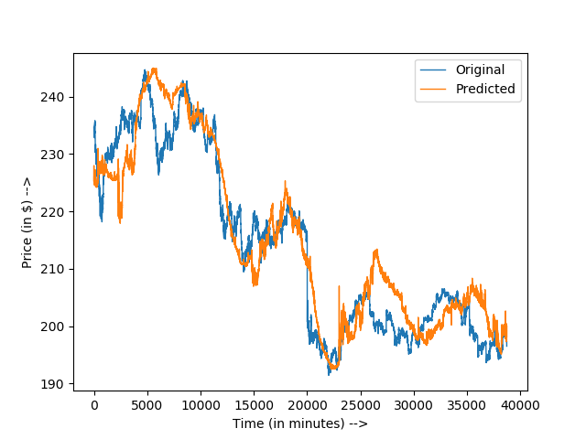
Graph 16: Closing Price Prediction for 3000 minutes later for MMM

Slide 64
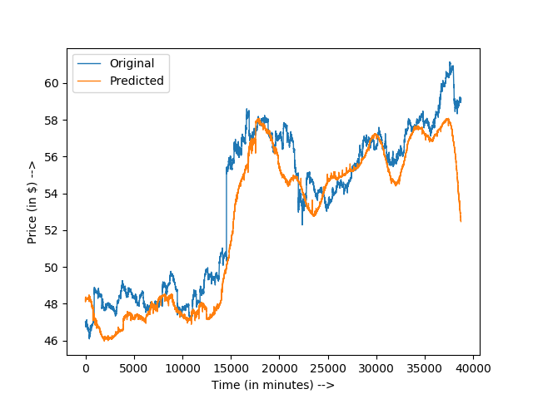
Graph 17: Closing Price Prediction for 3000 minutes later for CVX

Slide 65
Limitations and Future Work
Mode Collapse
Many more features need to be taken into consideration e.g: company policy, news about the company
The assumption made is the dataset is Markovian.
Have not tested the model on more companies.

Slide 66
Conclusion
For the next minute predictions, the results of the proposed models are comparable to that of the Regression techniques but beats the LSTM model.
1
For the third-day and the seventh-day predictions, the results of the proposed model are superior than the results of all the other techniques.
2

Slide 67
Part II: Opioid Incident Prediction

Slide 68

Introduction
What is the Opioid Epidemic?
What is being done to combat the Opioid Epidemic?
How can the research community help with respect to the Opioid Epidemic Problem?

Slide 69
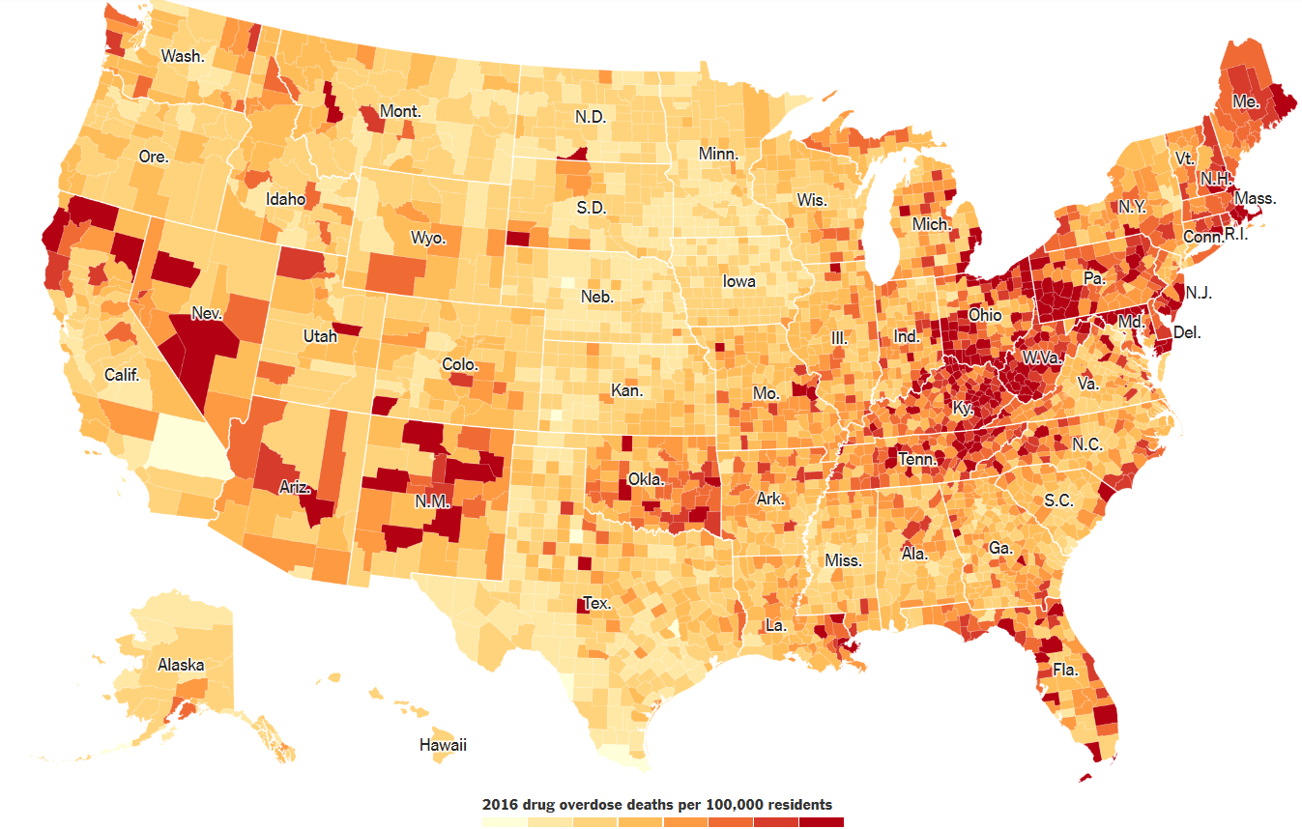
Opioid Overdose Heatmap of the US (Katz and Goodnough 2017)

Slide 70
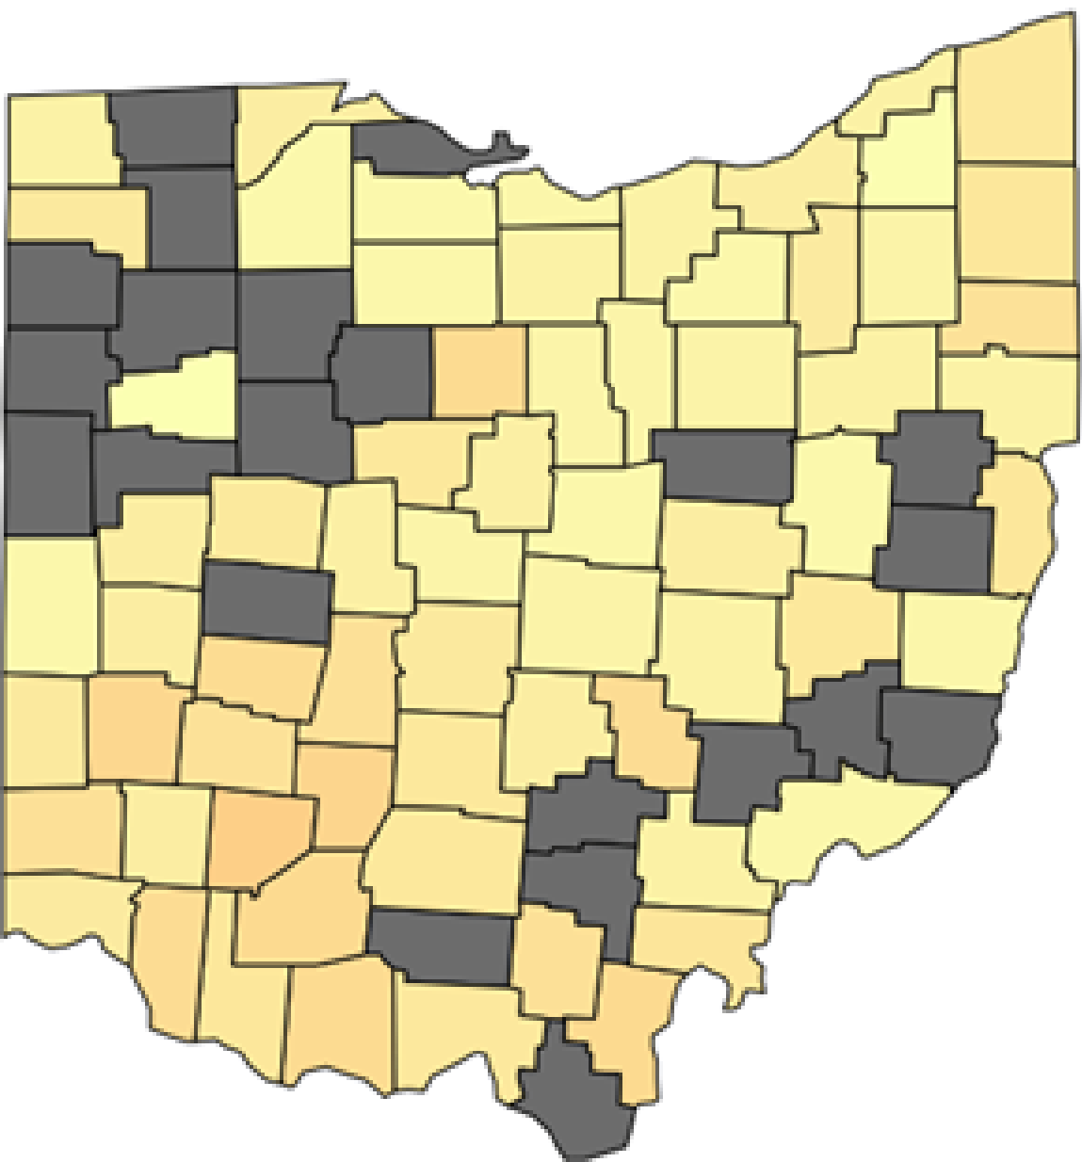

Heat maps can look like…
Courtesy: Google Images

Slide 71
Problem Statement
Predict the opioid heat map for a future time instance given the opioid heat maps of the past time instances.

Slide 72
Input Data
2 Datasets
3 features used to make heat maps

Slide 73
Datasets
Cincinnati Dataset
Launched by the City of Cincinnati and contains detailed information regarding an Opioid-related incident in Cincinnati (Cincinnati 2019).
Incidences ranging from January 2016 till May 2019.
Has 7191 recorded Opioid incidences spanning 1235 days.
Connecticut Dataset
Launched by the State of Connecticut and contains detailed information regarding an Opioid-related incident in Connecticut (Connecticut 2019).
Has 1612 mortality records.
Incidences ranging from January 2012 to December 2017.

Slide 74
3 features that were interesting…
Latitude coordinates of Opioid Incident Occurrence
Longitude coordinates of Opioid Incident Occurrence
Date of Opioid Incident Occurrence

Slide 75
Concepts

Slide 76
Encoder-Decoder Framework
The Encoder-Decoder framework is a neural network divided into two parts:
Encoder: a neural network where the number of units in every hidden layer is lesser than the number of units in the input layer.
Decoder: a neural network where the number of units in every hidden layer is greater than the number of units in the input layer.
When combined, the encoder-decoder framework aims to efficiently represent the initial input i.e. can map the input into a new input space.

Slide 77
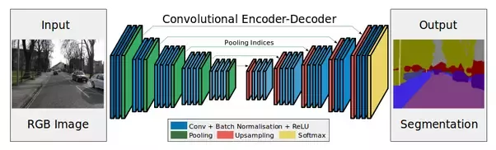
Encoder-Decoder
Courtesy: Google Images

Slide 78
Transposed Convolutional Neural Network
Transposed Convolution is used to conduct up-sampling.
For example, in a CNN layer, the input is of size 4x4, filter size of 3x3, a stride of 1x1 and no padding; we will get an output of size 2x2. If the need arises to up-sample the 2x2 matrix into the 4x4 matrix, Transposed Convolution is used.

Slide 79
Max Pooling
Max pooling is a sample-based discretization process which is used to down-sample an input representation, reducing its dimensionality and allowing for assumptions to be made about features contained in the sub-regions binned.
This is done to help over-fitting by providing an abstracted form of the representation and to reduces the computational cost by reducing the number of parameters to learn and provides basic translation invariance to the internal representation.

Slide 80
Implementation

Slide 81
Generating the Input Heat Maps…
We extract the Latitude, Longitude and Date from the Input Dataset.
The latitude and longitude ranges of the geographical location(i.e. Cincinnati or Connecticut) is given as input.
For every day in the input dataset, a black and white heat map is generated where the white dots on a black background represent the location of an opioid incident on that day.

Slide 82
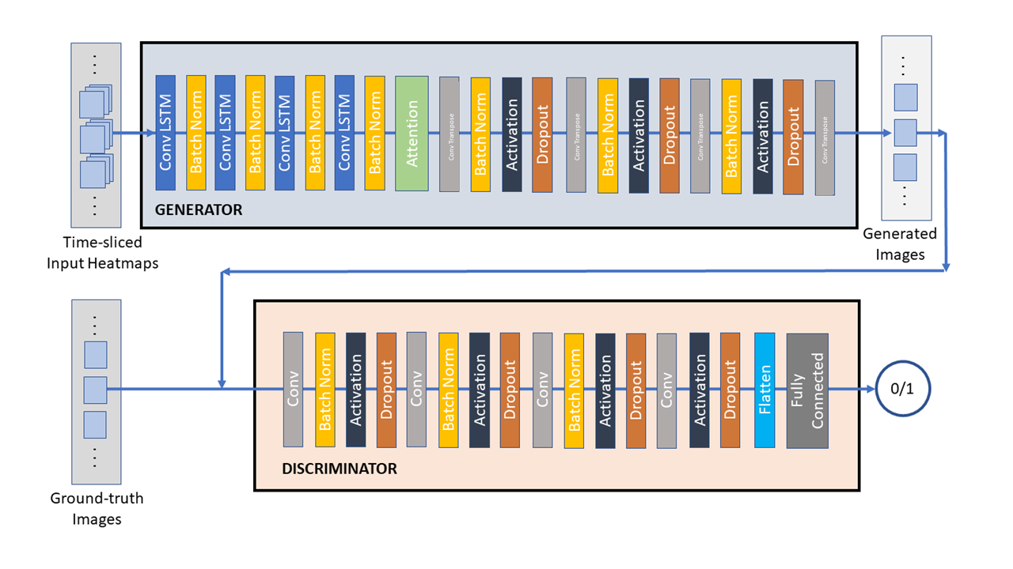
GAN Model for Opioid Incident Prediction Problem

Slide 83
Model Structure
Generator:
Two-Dimensional Convolutional LSTM layer with 16 units, a 3x3 filter, a 1x1 stride and ‘same’ padding.
Batch Normalization Layer
Two-Dimensional Convolutional LSTM layer with 32 units, a 3x3 filter, a 1x1 stride and ‘same’ padding.
Batch Normalization Layer
Two-Dimensional Convolutional LSTM layer with 64 units, a 3x3 filter, a 1x1 stride and ‘same’ padding.
Batch Normalization Layer
Two-Dimensional Convolutional LSTM layer with 128 units, a 3x3 filter, a 1x1 stride and ‘same’ padding.
Batch Normalization Layer
Attention Layer
Two-Dimensional Transposed Convolutional Neural Network layer with 128 units, a 3x3 filter, a 1x1 stride and ‘same’ padding.
Batch Normalization Layer

Slide 84
Model Structure(contd.)
Generator(contd.):
Leaky ReLU Activation Layer with α = 0.2
Dropout with dropout rate = 0.3
Two-Dimensional Transposed Convolutional Neural Network layer with 64 units, a 3x3 filter, a 1x1 stride and ‘same’ padding.
Batch Normalization Layer
Leaky ReLU Activation Layer with α = 0.2
Dropout with dropout rate = 0.3
Two-Dimensional Transposed Convolutional Neural Network layer with 32 units, a 3x3 filter, a 1x1 stride and ‘same’ padding.
Batch Normalization Layer
Leaky ReLU Activation Layer with α = 0.2
Dropout with dropout rate = 0.3
Two-Dimensional Transposed Convolutional Neural Network layer with 16 units, a 3x3 filter, a 1x1 stride and ‘same’ padding.

Slide 85
Model Structure(contd.)
Discriminator:
Two-Dimensional Convolutional Neural Network layer with 16 units, a 3x3 filter, a 1x1 stride and ‘same’ padding.
Batch Normalization Layer
Leaky ReLU Activation Layer with α = 0.2
Dropout with dropout rate = 0.25
Two-Dimensional Convolutional Neural Network layer with 16 units, a 3x3 filter, a 1x1 stride and ‘same’ padding.
Batch Normalization Layer
Leaky ReLU Activation Layer with α = 0.2
Dropout with dropout rate = 0.25
Two-Dimensional Convolutional Neural Network layer with 16 units, a 3x3 filter, a 1x1 stride and ‘same’ padding.
Batch Normalization Layer
Leaky ReLU Activation Layer with α = 0.2
Dropout with dropout rate = 0.25
Two-Dimensional Convolutional Neural Network layer with 16 units, a 3x3 filter, a 1x1 stride and ‘same’ padding.
Batch Normalization Layer
Leaky ReLU Activation Layer with α = 0.2
Dropout with dropout rate = 0.25
Flatter Layer
Dense

Slide 86
Loss Function
Combination of Wasserstein Loss and MSE.
The Wasserstein loss calculates the distance between the two probability distributions but not how far apart the predicted values are. Hence MSE is also incorporated in the loss.
This is the formula of the loss function used:
$$L_{GAN}=0.6∗L_{Wasserstein}+0.4∗L_{MSE}$$

Slide 87
Comparison Models
Convolutional LSTMs (ConvLSTMs):
A classic five-layer ConvLSTM model with Global Average Pooling as the last layer.
Time-Distributed version of Convolution Encoder-Decoder Framework built upon the UNet++ model (Zhou et al. 2018) (TD Conv-Env-Dec):
A classic Encoder-Decoder framework which takes the time distributed heat maps as input and produces future heat maps as output.

Slide 88
Comparison Models (contd.)
Attention-based ConvLSTMs (Att-ConvLSTMs) (A variant of the model present by (Byoen et al. 2018)):
Two-Dimensional Convolution LSTM Layer with 64 units, a 3x3 filter, a 1x1 stride and ‘same’ padding.
Max Pooling with a 2×2 filter
Two-Dimensional Convolution LSTM Layer with 128 units, a 3x3 filter, a 1x1 stride and ‘same’ padding.
Max Pooling with a 2×2 filter
Two-Dimensional Convolution LSTM Layer with 256 units, a 3x3 filter, a 1x1 stride and ‘same’ padding.

Slide 89
Results
Tables 7 to 8 shows the results of the proposed model versus the existing models.
Outputs for Cincinnati and Connecticut Datasets follows the tables.

Slide 90
Table 7: Evaluation Results of the following methods on Cincinnati dataset
Method | MSE | MAE
ConvLSTM | 0.0628 | 0.0083
Att-ConvLSTM | 0.04256 | 0.0062
TD-Conv-End-Dec | 0.0562 | 0.0075
GAN model | 0.03371 | 0.0057

Slide 91
Table 8: Evaluation Results of the following methods on Connecticut dataset
Method | MSE | MAE
ConvLSTM | 0.0583 | 0.0081
Att-ConvLSTM | 0.0415 | 0.0067
TD-Conv-End-Dec | 0.0517 | 0.0073
GAN model | 0.0309 | 0.0052

Slide 92
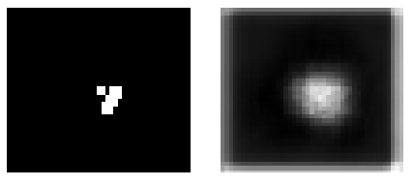
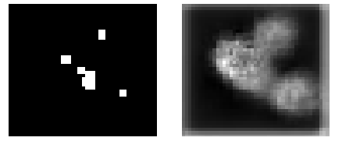
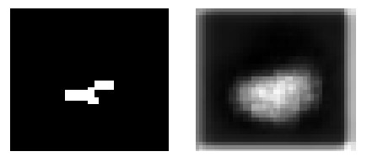
Some Cincinnati Dataset Outputs…

Slide 93
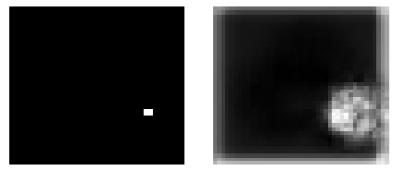
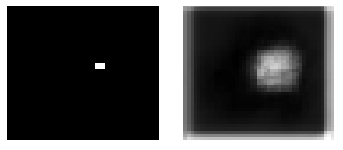
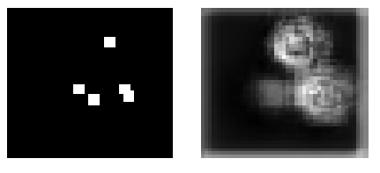
Some Connecticut Dataset Outputs…

Slide 94
Limitations and Future Work
Mode Collapse
Output Images are a fuzzy spread. Need to get a more accurate location pinpoint by using localization techniques such as non-maximal suppression.
Need to test the model on more datasets.

Slide 95
Conclusion
The GAN model can be used to predict future heat maps.
1
The proposed model is superior than the existing models.
2

Slide 96
References
Byeon, Wonmin, Qin Wang, Rupesh Kumar Srivastava, and Petros Koumoutsakos. "Contextvp: Fully context-aware video prediction." In Proceedings of the European Conference on Computer Vision (ECCV), pp. 753-769. 2018.
Cincinnati. 2019. Cincinnati Heroin Overdoses. https://insights.cincinnatioh.gov/stories/s/Heroin/dm3s-ep3u/
Connecticut. 2019. Accidental Drug Related Deaths. https://data.ct.gov/Healthand-Human-Services/Accidental-Drug-Related-Deaths-2012-2018/ecj5-r2i9
FirstRateData 2019. http://firstratedata.com/
Katz and Goodnough 2017. https://www.nytimes.com/interactive/2017/12/22/upshot/opioid-deaths-are-spreading-rapidly-into-black-america.html
NCSS 2019. https://ncss-wpengine.netdna-ssl.com/wp-content/themes/ncss/pdf/Procedures/NCSS/Ridge_Regression.pdf
Zhou, Zongwei, Md Mahfuzur Rahman Siddiquee, Nima Tajbakhsh, and Jianming Liang. "Unet++: A nested u-net architecture for medical image segmentation." In Deep Learning in Medical Image Analysis and Multimodal Learning for Clinical Decision Support, pp. 3-11. Springer, Cham, 2018.

Slide 97


Questions

Slide 98

Thank You!

